Slide 1
Digital Design
Ahmet Özmen
ozmen@sakarya.edu.tr
Not: These slides are prapared using other similar course materials available in the Internet.
Ref: http://www-inst.eecs.berkeley.edu/~cs152/index.html
Fall 2017
Page <number>

Slide 2
Outline
Course Materials
Course Structure & Grading
A Few Basic Principles of Digital Design
Fall 2017
Page <number>

Slide 3

Course Materials
Textbook:
  Digital Design, Third Edition
  M. Morris Mano
  Prentice Hall, 2002
Laboratory Materials:
  Altera tools and design libraries available online.
  Verilog reference online.
Fall 2017
Page <number>

Slide 4
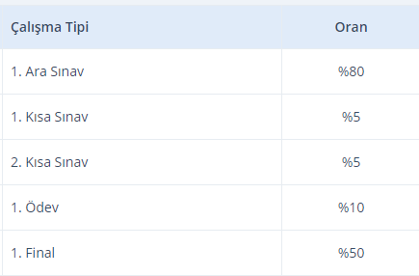
Course Structure and Grading
Fall 2017
Page <number>

Slide 5
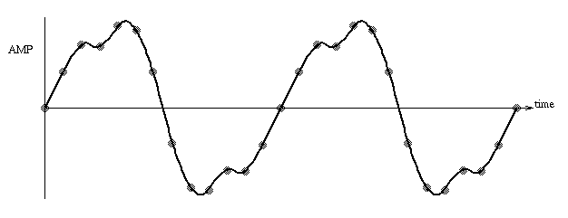
Course Content
Components and Design Techniques for Digital Systems
Synchronous Digital Hardware Systems
Synchronous: “Clocked” - all changes in the system are controlled by a global clock (not asynchronous)
Digital: All inputs/outputs and internal values (signals) take on discrete values (not analog).
  Example: sound waveform
  A series of numbers is used to represent the waveform, rather than a voltage or current, as in analog systems.
Fall 2017
Page <number>

Slide 6
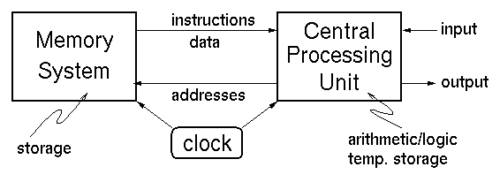
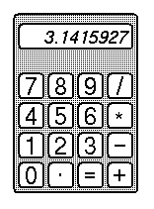
Example Digital Systems
Digital Computer
  Usually design to maximize performance. "Optimized for speed"
Handheld Calculator
- Usually designed to minimize cost.
“Optimized for low cost”
- Of course, low cost comes at the expense of speed.
Fall 2017
Page <number>

Slide 7
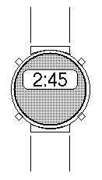
Example Digital Systems
Digital Watch
  Low power operation comes at the expense of:
    lower speed
    higher cost
Designed to minimize power.
Single battery must last for years.
Fall 2017
Page <number>

Slide 8
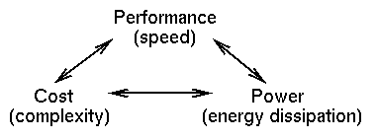
Basic Design Tradeoffs
You can improve on one at the expense of worsening one or both of the others.
These tradeoffs exist at every level in the system design - every sub-piece and component.
Design Specification -
  Functional Description.
  Performance, cost, power constraints.
As a designer you must make the tradeoffs necessary to achieve the function within the constraints.
Fall 2017
Page <number>

Slide 9
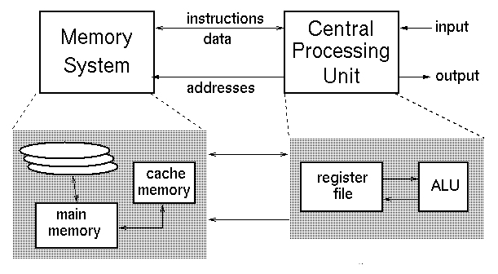
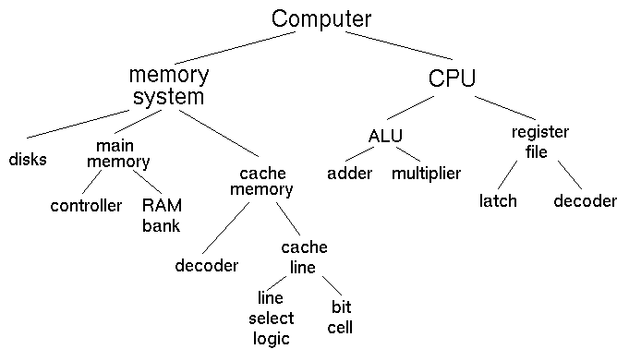
Design Representation
Fall 2017
Page <number>

Slide 10
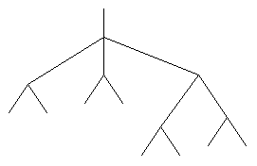
Hierarchy in Designs
Helps control complexity -
  by hiding details and reducing the total number of things to handle at any time.
Modulalizes the design -
  divide and conquer
  simplifies implementation and debugging
Top-Down Design
  Starts at the top (root) and works down by successive refinement.
Bottom-up Design
  Starts at the leaves & puts pieces together to build up the design.
Which is better?
  In practice both are needed & used.
    Need top-down divide and conquer to handle the complexity.
    Need bottom-up because in a well designed system, the structure is influence by what primitves are available.
Fall 2017
Page <number>

Slide 11
Digital Design
Given a functional description and performance, cost, & power constraints, come up with an implementation using a set of primitives.
How do we learn how to do this?
  1. Learn about the primitives.
  2. Learn about design representation.
  3. Learn formal methods to optimally manipulate the representations.
  4. Look at design examples.
  5. Use trial and error - CAD tools and prototyping.
Digital design is in some ways more an art than a science. The creative spirit is critical in combining primitive elements & other components in new ways to achieve a desired function.
Unlike art we have objective measures of a design:
  performance cost power
Fall 2017
Page <number>

Slide 12
Digital Design
Given a functional description and performance, cost, & power constraints, come up with an implementation using a set of primitives.
How do we learn how to do this?
  1. Learn about the primitives.
  2. Learn about design representation.
  3. Learn formal methods to optimally manipulate the representations.
  4. Look at design examples.
  5. Use trial and error - CAD tools and prototyping.
Digital design is in some ways more an art than a science. The creative spirit is critical in combining primitive elements & other components in new ways to achieve a desired function.
Unlike art we have objective measures of a design:
  performance cost power
Spring 2002
EECS150 lec01-intro
Page <number>

